Slide 1
Revolutionizing healthcare
by visualizing metabolic stress

Slide 2
The problem
Healthcare challenge
PAIS (Long Covid, ME/CFS) + fibromyalgia: debilitating fatigue and cognitive impairment; 75% women
Common: LongCovid-450k (NL), Fibromyalgia-450k (NL)
Lack of mechanistic understanding:
Diagnosis: time-consuming, expensive
No proper treatment or cure

Slide 3
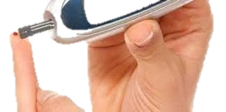
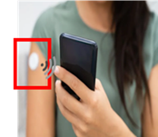
Our solution
Streasure4Health: understanding mechanism
Development objective & quantitative diagnosis: biosensor technology
Empowers clinicians to:
Accurately diagnose patient’s physical and mental resilience.
Prescribe appropriate physical and/or mental therapies.
Monitor effectiveness of therapies with measurable outcomes -> lifestyle

Slide 4
Consortium
EWUU
Societal
Patients
SME
Others
Notes:
We solve this problem for clinicians by analysing the change in blood factor x between pre and post exercise. Upon a large increase, the patient’s physical resilience is good enough to prescribe graded exercise therapy, whereas this should not be advised to patients with no increase.
Importantly, because the diagnosis is based on the underlying mechanism causing longCovid and other PAIS, the diagnosis is the ONLY tool clinicians will have to identify/develop and prescribe a patient-specific therapy, further extending the expected revenues.

Slide 5
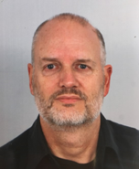
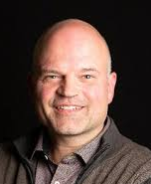
Streasure4Health Team
Expert team with deep experience in metabolic stress and energy metabolism.
Founder/CSO
Prof. Peter Deen
CEO
Koen Jacobs
COO
Dr Peter Voshol

Slide 6
Desired expansion of Consortium/team
Biosensor development: Exploring technical partners; TuE?
Looking for ‘biosensor’ CTO
Socially-oriented investors
contact:
Peter Deen
info@streasure4Health.com
+31-645321871

